Slide 1


Fall Summit 2018
Dave Neuman
Chair - Apache Traffic Control

Slide 2
Logistics/Housekeeping
Facilities:
Bathrooms
Coffee, Tea, Water
Getting in and out of the suite
Schedule: https://s.apache.org/atcfall2018
Videos: https://s.apache.org/atcvids
Twitter: @trafficctrlcdn
Lightning Talk Sign Up
Meals
Reception
5:30 at the Cherry Cricket Ballpark
2220 Blake St, Denver, CO 80205

Slide 3
Slack
traffic-control-cdn.slack.com - https://s.apache.org/atc-slack
Currently have about 370 users
Good place to get support, ask questions, etc
Decisions are still made via email lists
#tc-meetup for summit information, coordination, etc

Slide 4
Since our last summit (April 2018)...
We became a TLP!!!
Released Traffic Control 2.2
491 Pull Requests submitted
453 Pull Requests closed
1400+ commits to Master
36 unique contributors
257 Issues opened
112 Issues Closed/Resolved
283 emails on dev list by 40 people divided into 47 topics
58 emails on users list by 17 people divided into 11 topics
Added ~100 users to Slack

Slide 5

New Committer -- Rawlin Peters
Works for Comcast
Contributed many large features such as Geolocation Client Steering
Currently working on flexible cache groups
Familiar with all ATC Components
rawlin@apache.org

Slide 6

New Committer -- Dylan Volz
Works for Google
Helped with Perl -> Golang migration
Large role in architecting Traffic Ops API framework
Very knowledgeable on Traffic Ops golang API
dylan@apache.org

Slide 7
3.0 Release
What’s New:
Traffic Router has been upgraded to use Tomcat 8.5.x
Traffic Router is now it’s own service `systemctl stop|start|restart traffic_router` instead of `systemctl stop|start|restart tomcat`
ATC no longer supports Centos < 7
Java Traffic Monitor removed from code base
Traffic Ops UI now has a message that it will be deprecated
Traffic Portal should have feature parity with TO, there are a few exceptions (like DNSSEC)

Slide 8
3.0 Release
What’s New Cont’d:
Backup edge cache group configuration - Let’s a user configure backup edge cache groups instead of using the default of next closest
More Golang migrations
Geolocation based client steering - TR can now steer clients to closest origin
Tenancy is now the default behavior in Traffic Ops
Cache group localization - cache group API now supports an optional `localizationMethods` field which specifies the localization methods allowed for that cache group
Changelog: https://github.com/apache/trafficcontrol/blob/3.0.x/CHANGELOG.md

Slide 9

3.0 Release
RC0 has already been -1ed due to regression bugs
Need help testing RC1 once it is released
Targeting Mid-November release

Slide 10
Github
PR Template Introduced
Meant to make things better for mergers
Not meant to be “a stick”
Open Issues
Lots of open issues, some are very old. Let’s spend some time on seeing which are still real issues.
Pull Requests
Lots of open pull request
Work on finding a committer to help merge, don’t just “fire and forget”
Changelog
Make sure to make Changelog updates for new features and bug fixes
Can remove this by squashing commits and adding a good commit message

Slide 11
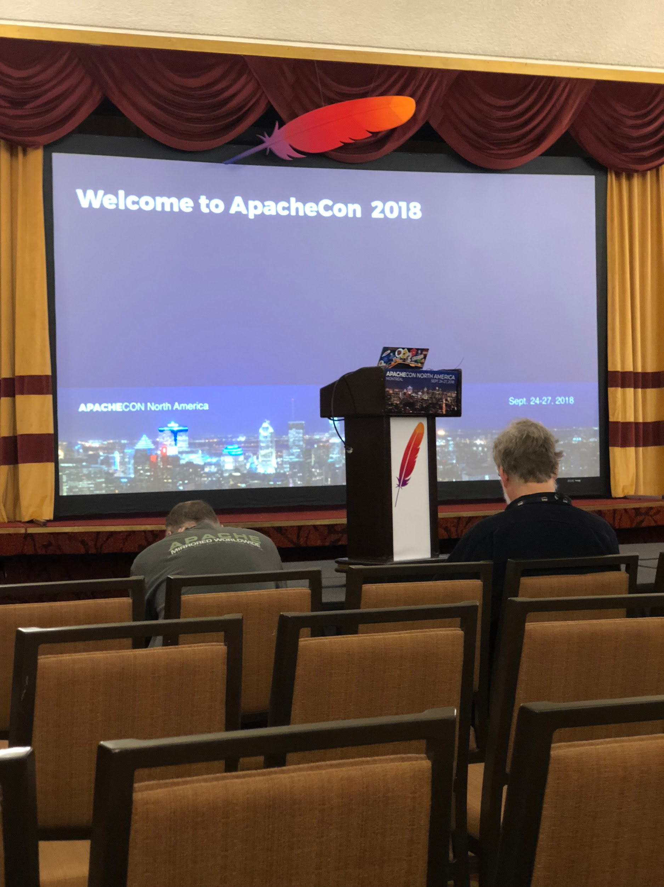
ApacheCon North America 2018
Held in Montreal a few weeks ago, Sept 24th - 27th
350+ Attendees
Tomcat, Cloudstack
Lots of Fintech talks, Kafka, Beam, Spark, etc
Big Companies were well represented (IBM, Microsoft)
“Community Over Code”
3 Traffic Control Talks

Slide 12
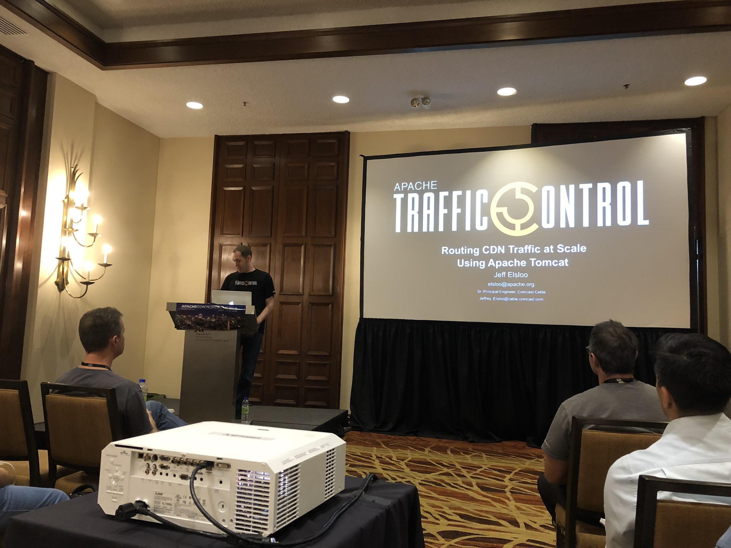
Jeff Elsloo - Routing CDN traffic at scale using Apache Tomcat
Tuesday on the Tomcat Track
The move to Tomcat 8.5.x
Use of OpenSSL for TLS - performance improvements
Custom connectors and classes
Gotchas we experienced in production
Presentation: https://s.apache.org/atc-acna-2018

Slide 13
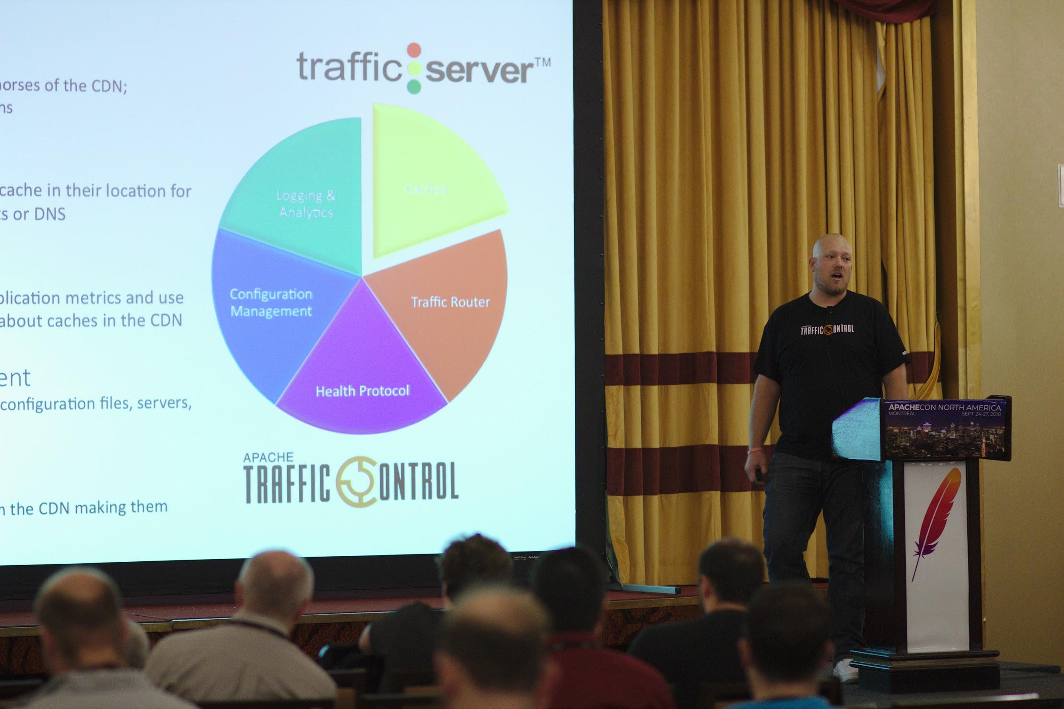
Dave Neuman - Streaming Media at Scale: The story of ATC
One of 4 Wednesday morning keynotes
Why we built the IPCDN at Comcast
History of Apache Traffic Control
Why we chose Apache
Presentation: https://s.apache.org/atc-acna-2018

Slide 14
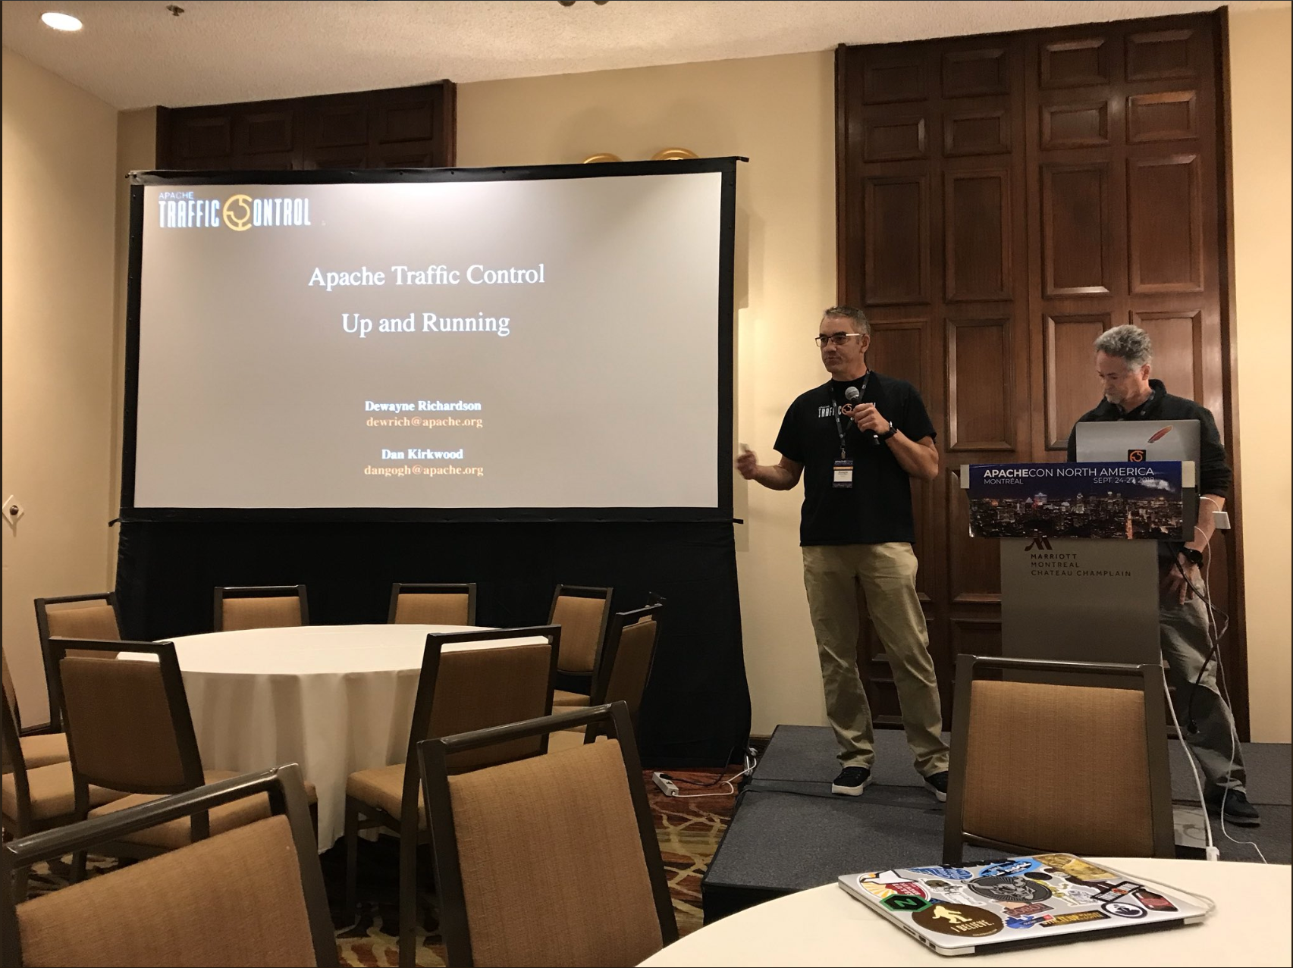
Dewayne Richardson/Dan Kirkwood - ATC Up and Running
Thursday Afternoon Session
Overview of ATC
Explanation of all components
Live Demo of all components in Docker
Docker code is in master
Presentation: https://s.apache.org/atc-acna-2018

Slide 15
The Apache Way...A Refresher
Charity​​​​ -- Providing software for the public good
Pragmatic​​​​ -- Broadly permissive licenses
Openness​​​​ -- All project discussions that lead to project decisions take place in public
Meritocracy​​​​ -- Those that have proven they can do, get to do more
Consensus​​​​ -- Getting good enough consensus is better than voting
Community Over Code​ -- The health of the community is more important than the quality of the code

